Slide 1



Achieving Low Tail-latency and High Scalability for Serializable Transactions in Edge Computing
Xusheng Chen, Haoze Song, Jianyu Jiang, Chaoyi Ruan, Cheng Li,
Sen Wang, Gong Zhang, Reynold Cheng, Heming Cui.
The University of Hong Kong
University of Science and Technology of China
Huawei Technologies
Notes:
Hello everyone, I am Chen Xusheng from the University of Hong Kong.
Today I present DAST, the first serializable databases that can achieve both low tail latency and high scalability in edge computing.

Slide 2


Emerging mission-critical applications in edge computing desire strong transactional support (i.e., serializability)
Edge computing: move computation close to clients.
Low latency, data locality, resistance to WAN churns, etc.
Serializability: transactions equivalent to execute sequentially.
Strongest isolation guarantee; avoids application-level bugs.
Emerging mission-critical edge computing applications:
Smart city management, industry 4.0 systems, edge computing-based trading, UAV& aviation schedule control, etc.
Requires both low tail-latency and serializability
Existing edge databases target non-mission-critical scenarios.
E.g., content delivery networks (CDN).
Provides only weak isolation guarantees.
E.g., SEQ [SRDS ‘07], T-Cache [ICDCS ‘15], Gesto [ICCCN ‘20].
Notes:
Edge computing is a fast-developing computing paradigm that moves the computation resource from the core data centers far away from clients to the edge of Internet that is close to clients, so that it can exploit clients’ data locality and provide low client-perceived latency.
Edge computing is already widely deployed in many use cases like the CDN networks to improve user experience.
Recently, with the development of the ultra-reliable and low-latency communication technologies like the 5G network, a new class edge computing applications that deals with mission-critical tasks emerges.
For instance, a NASA project tries to integrate the management of UAV networks the management of normal airplanes to schedule air traffic and to avoid collisions.
These mission-critical applications desire very low tail-latency for a stable response time, and at the same time, their rigorous correctness requires serializable transactional support, because serializability is the strongest isolation level and can avoid many application level bugs.
However, as existing edge computing databases targets only non-mission-critical use cases like CDN network, they provide only weak isolation guarantees.
To meet this new trend, in this project, we build a distributed edge computing databases that can ensure both the low tail-latency and serializability.

Slide 3


Deployment model of edge computing databases differs from traditional geo-distributed databases
Region n
Nodes and clients are divided into regions.
Each data shards is assigned to one region.
i.e., partial replication.
Two types of transactions.
Intra-region transactions (IRT): accesses only shards in the region of the client.
Cross-region transactions (CRT): accesses shards owned by other regions.
Typical edge computing application show good locality.
Most transactions are IRT.
Region m
Region 1 (New York)
Shard A
Shard B
fast intra-region network
(e.g., RTT < 10 ms)
IRT
Shard A
Shard B
slow inter-region network
(e.g., RTT > 100 ms)
CRT
Shard C
Shard D
fast Intra-region network
(e.g., RTT < 10 ms)
Shard C
Shard D
Region 2 (e.g., London)
Notes:
Different from traditional databases, in a typical edge computing database, nodes and clients are divided into regions, and nodes in a region manage only data shards that are most frequently accessed by intra-region clients.
The Intra-region network is usually much faster than cross-region networks, so the replication is done within each region for low latency.
In such a deployment model, client transactions can be divided into two categories. We call a transaction an IRT if it access only data shards in this region, otherwise, we call it a CRT.
Because typical edge computing applications show good locality, IRTs take a great portion of all transactions.

Slide 4
Technical requirements to achieve serializability and low tail-latency in an edge computing database
(R1): CRTs under coordination should not block IRTs.
Otherwise, IRTs’ latency will be high.
(R2): CRTs should not be aborted on conflicts.
Otherwise, CRT may starve.
Otherwise, IRTs need to wait for the commit result of CRTs
(R3): Scalable to a large number of regions.
Notes:
Under such a deployment model, we summarize three technical requirements for an edge computing database that ensures serializability and low-tail latency.
First, when a cross-region transactions is under coordination, subsequent IRTs should not be blocked. Because the average latency for IRTs is only a few or a few tens of milliseconds, but the latency of CRTs can be hundreds of milliseconds . If IRTs are blocked, their tail-latency will be very high.
Second, a CRT should not be aborted on conflicts. A naïve approach to meet R1 is to abort a CRT whenever it conflicts with IRTS. However, because in the lifetime of a CRT, many IRTs can be submitted and finished, such a design will cause CRTs to be repetitively aborted and starve. Moreover, if an IRTs sees the intermittent result of a CRTs, the IRT must be blocked to wait for the commit result of the CRT before it can commit.
Third, as an edge computing application may have up to hundreds of regions, the database’s performance should be scalable to a large number of regions.

Slide 5
Traditional serializable databases are not designed to meet R1, R2, R3 in edge computing
Much influential work greatly improves the average throughput and latency for geo-distributed databases deployed in a few large data centers.
They typically order transactions in a first-come-first-serve (FCFS) manner.
Easy to achieve a high average throughput and low average latency.
Deferred update approach (e.g., Tapir [SOSP ‘15], Carousel [SIGMOD ’19]): CRTs may starve (R2).
SMR approach (e.g., Calvin[SIGMOD ‘12], Janus [OSDI ‘16], SLOG[VLDB ’19]): IRTs are blocked by CRTs (R1).
Region 1
W (A = A + 1)
A
recv IRT₁
exec IRT₁
exec CRT₁
RTT = 100 ms
prepare
OK
commit
read A
W (B = B * 1.1)
B
recv CRT₁
recv IRT₂
exec CRT₁
exec IRT₂
Region 2
R(x = A);
W(B = x + 1);
Block and wait for inputs
Notes:
Although there are many influential geo-distributed serializable databases that can achieve good performance when deployed among a few core data centers, they are not designed to meet the three requirements if deployed on the edge.
A key reason is that theses systems order transactions in a first-come-first-serve manner, based on transactions arrival order at replicas or a central ordering service.
These systems can be divided into two categories.
The first category takes the deferred update approach, where transactions are first executed locally and then verified globally. However, such an approach generally cannot meet R2 as CRTs can get repetitively aborted at the verification phase.
The second category takes the SMR approach, where transactions are first assigned an order, and then executed at relevant nodes according to this order. However, such an approach cannot meet R1.
We use a simple example to demonstrate the reason . These are the time axises for two objects A and B in two regions. Suppose a CRT that sets B to A+1 is submitted and coordinated using a standard two-phase commit. After object A prepares the CRT, an IRT is submitted to object A , but this IRT must be blocked until the CRT finishes.
Similarly, when object B is waiting for the read value of A, and an IRT arrives, this IRT must be blocked as well.
Explain R and W.

Slide 6
DAST: Decentralized Anticipation and STretch
Different from the FCFS approach, DAST orders transactions based on when their coordination (incl. replication) is anticipated to have finished.
i.e., they are ready to execute.
Stretch the granularity of timestamps to cope with:
Inaccurate anticipations
blockings caused by cross-region data reads.
Region 1
100
120
W (A = A + 1)
200
A
recv&exec IRT₁
exec CRT₁
prepare
anticipate
ts = 200
commit
ts = 200
read A
RTT = 100 ms
TODO
Animation
W (B = B * 1.1)
B
recv CRT₁
recv&exec IRT₂
exec CRT₁
Region 2
50
R(x = A);
W(B = x + 1);
199
200
199.(1)
199.(2) …
Notes:
To address this problem, in this paper, we presents a conceptual method DAST, Decentralized anticipated and stretch.
DAST also takes the SMR approach, but DAST orders transactions based on when transactions’ coordination is anticipated to have finished and thus are ready to execute.
Conceptually, in the previous example, DAST assigns an anticipated timestamp 200 to the CRT and assigns the subsequent IRT_1 a smaller timestamp 120. By doing so, although the IRT arrives later , it is ordered before the CRT without being blocked.
Note that this is not a simple local reordering because region_1 can have many data shards with replication, and IRTs can access multiple intra-region shards. Doing a simple local-reordering cannot ensure consistency.
To handle the blocks caused by inaccurate anticipation and cross-region data reads, DAST dynamically stretches the graduality of timestamps. For instance, when object B is waiting for the value of A to execute CRT_1 at timestamp 200, it stretches out its granularity of clocks after passing 199, and assigns 199.1 to IRT_2, avoids it getting blocked.

Slide 7
How to anticipate a timestamp for a CRT
Challenge 1: must be in the future of all participating nodes’ clocks.
Challenge 2: no global ordering service.
Strawman approach: let a single node assigns a timestamp of the transaction.
DAST’s approach: a new two-phase decentralize anticipation protocol that complies with 2PC.
Promise not to execute any transaction with ts > 200 before T₁
What if IRT arrives? Use DAST’s hybrid clock!
This node knows it has promised not to pass 200!
Region 1
A
exec T₁
100
200
220
230
RTT = 100 ms
anticipate
T₁.ts = 200
commit
T₁.ts = 230
ts_max = max anticipated_ts,
ts_max >= each region’s promised ts
Region 2
B
recv T₁
50
150
170
anticipate
T₁.ts = 230
commit
T₁.ts = 230
RTT = 120 ms
Region 3
C
exec T₁
110
230
Notes:
A key challenge to realize the conceptual method of DAST is to anticipate a proper timestamp for a CRT, without involving a central service for ensuring scalability.
The timestamp must be in the future of all participating nodes’ clock to avoid the CRT getting aborted, but timestamp cannot be conservatively large for the CRT’s own latency.
A strawman approach is to let a single node such as the coordinator solely determines a future timestamp. However, when the CRT arrives at its participating nodes, their clocks may have already passed due clock skewness and network instability, causing the CRT being aborted.
To address this challenge, we purpose a new two-phase anticipation protocol that compiles with standard 2PC.
Consider three objects A,B,C in three regions and a CRT accessing these three objects. For simplicity, we assume that network is stable, and clock is synchronized but note that DAST’s protocol does not needs such assumptions.
In the first phase, each node anticipates a future timestamp based on the RTT between itself and the coordinator B, representing when it can receive the commit message for T_1. Each node also promises not to execute transactions with timestamps lager than its anticipated timestamp to avoid T_1 gets aborted.
In the second phase, the coordinator B selects the maximum anticipated timestamp ts_max and commit T-1 with its. T_1 being the maximum anticipated timestamp implies that all participating nodes promised not to execute transactions larger than ts_max, so T_1 will not be aborted.
A problem here is that object A promised not execute transaction larger than 200, but it can only receive the commit message at time 220. What if IRT arrives during this time?
This is exactly why we need DAST’s hybrid clock. Object A can start to stretch its timestamps granularity after its clock passed 199.
Our new protocol does not need any central service, and it is based on 2PC to achieve the minimal number of round trips for a CRT.

Slide 8
The correctness guarantee of DAST
One-copy serializability and no stale reads.
A key correctness invariant of DAST:
When a node N executes any transaction T with timestamp ts, the node must have executed all relevant transactions with timestamps smaller than ts.
All edges in the dependency graph are in ascending timestamp order.
No cycles -> serializability.
Complete history -> no stale reads.
Notes:
DAST ensures one-copy serializabilitiy and no stale reads.
To achieve this guarantee, DAST ensures this following key correctness invariant: When a node N executes any transaction T with timestamp ts, the node must have executed all relevant transactions with timestamps smaller than ts.
By ensuring this invariance, we can deduce that all edges in the dependency graph are in ascending timestamp order. This ensures two key features:
First, the global dependency graph has no cycles, which infers serilizability according the serializability theory.
Second, each node must have a complete history when executing transaction T, which infers that all read will read the latest read without any staleness.

Slide 9
Efficiently ensuring correctness
Correctness invariant: when a node N executes any transaction T with timestamp ts, the node must have executed all relevant transactions with timestamps smaller than ts.
N must be aware of all relevant transactions whose timestamps < ts.
Challenge: These transactions may not even be generated due to clock skewness.
Existing approach (e.g., Ocean Vista [VLDB ’19]): maintaining a system-wide watermark w, execute T if w > ts.
All nodes’ clocks > w, nodes no new transactions preceding w can be generated .
All transactions preceding w are replicated .
Very high throughput in traditional geo-distributed databases among a few large data centers.
IRTs’ latency will be very high!
DAST’s approach: each node tracks the clocks of only intra-region nodes.
DAST’s two-phase anticipation protocol: the CRT’s timestamp must > all participating nodes’ clock!
Notes:
To ensure this invariant, N must be aware of all relevant transactions whose timestamps are smaller than ts.
The key challenge here is that these transactions may not even be generated due to clock skewness .
Existing traditional geo-distributed databases address this problem by maintaining a system-wide watermark, and N can execute T if w is larger than ts because no new transactions preceding T will be generated.
This approach can ensure a very high throughput in traditional geo-replicated databse.
However, this approach will also cause very high latency for IRTs in an edge database because executing an IRT needs to wait for all nodes clock passes the IRT’s timestamp.
In DAST, each node only tracks the clocks of Intra-region nodes.
This is enabled by DAST’s new two-phase anticipation protocol; Recall that in the two-phase anticipation protocol, if a CRT accesses N’s region and may conflict with T, the CRT’s timestamp must be larger than all participating nodes clock.
Therefore, by only knowing all intra-nodes’ clocks passes ts, and all transactions coordinated by these intra-region nodes are well received, N can predicate that it is safe to execute T.

Slide 10
Handling a (suspected) node failure
Fast failover: quickly remove the suspected failed node using 2PC.
Asynchronous recovery: adding back a replica.
Challenge: How to set the clock value C of the newly added node?
Correctness: no nodes should have executed transactions with timestamps > C.
The normal transaction processing should not be stopped.
Let C be conservatively large -> proposed transactions have very long latency.
DAST’s approach: model this process as a special CRT accessing all intra-region node.
Notes:
To handle node failures. DAST distinguishes the process of fast failover that removes the suspected failed node and the process of asynchronous failure recovery that adds back a replica.
When adding a replica, a challenge is how to set the clock of the newly added replica.
For correctness, the new replica’s clock must be larger than all nodes’ executed transactions’ timestamps so that it will not propose a transaction in the past and break DAST’s correctness. However, when the replica is being added, other nodes keeps executing transactions, so their executed transactions’ timestamps keep increasing .
To solve this problem, we model the process of adding a replica as a special CRT that accesses all nodes in the region and uses DAST’s hybrid clock with stretchable granularity to minimizes the disturbance of normal transaction processing. We provide a detailed description with pseudo code of this protocol in our paper.

Slide 11
DAST ensures R1, R2, R3 with serializability
(R1): CRTs under coordination should not block IRTs.
DAST assigns CRTs timestamps representing when their coordination is anticipated to finish.
If anticipation is inaccurate, or the CRT has cross-region reads => DAST’s hybrid clock.
(R2): CRTs should not be aborted on conflicts.
DAST takes the SMR approach.
A CRT’s timestamp is larger than the clocks of participating nodes.
(R3): Scalable to a large number of regions.
No central service: committing a CRT only involve participating regions.
Serializability no stale reads:
When a node executes any transaction T with timestamp ts, the node has executed all relevant transactions with timestamps smaller than ts.
Notes:
Overall, DAST ensures the three crucial technical requirements and ensure serializability.
To ensure R1, DAST assigns CRTs to future timestamps representing when they can execute, and uses the hybrid clock with stretchable granularity for handling inaccurate anticipation or cross-region reads.
To ensure R2, DAST uses the SMR approach and DAST two-phase anticipation protocol ensure that a CRT’s timestamp is larger than the clocks of participating nodes.
Dast is scalable to the number of regions because committing a transaction only involves participating regions.
DAST ensure Serializability with no stale reads by ensure that when a….., this implies all dependency edges are in ascending timestamp order, so the global dependency graph is acyclic. We have included a proof of DAST guarantees in our paper.

Slide 12


Comparison with existing work
(R1): CRTs under coordination should not block IRTs.
(R2): CRTs should not be aborted on conflicts.
(R3): Scalable to a large number of regions.
 | DAST | Tapir [SOSP ’15] | Carousel [SIGMOD ’18] | Calvin [SIGMOD ’14] | Spanner [OSDI ’12] | Janus [OSDI ’16] | SLOG [VLDB ’19] | OV [VLDB ’19] | DPaxos [SIGMOD ’19] | T-Cache [ICDCS ’15] | Gesto [ICCCN ’20]
Serializable
R1 |  |  |  |  |  |  |  |  | n/a. | n/a.
R2 |  |  |  |  |  |  |  |  | n/a. | n/a. | n/a.
R3
Deferred update (optimistic) approach
SMR-based (pessimistic) approach
Traditional geo-distributed databases
Databases for edge computing
Notes:
Compared to existing work, DAST is the first distributed database that can meet all the three requirements and serializability.
While existing traditional serializable databases are not designed to meet the three technical requirmens on edge,
And existing database for edge computing target non-mission-critical scenarios and does not ensure serialziabilty.

Slide 13

Evaluation
Evaluation settings:
Intra-region RTT = 5ms, Cross-region RTT = 100ms.
10~100 regions. Each region contains 10 shards with the replication level of 3.
Workloads: TPC-C default TPC-C payment-only, and TPC-A.
Good locality; covers different read-write patterns; evaluated by baseline systems.
Each client is assigned to a shard (i.e., TPC-C warehouse ID); the client resides in the region holding this shard.
Baseline systems.
Tapir [SOSP ’15, TOCS ’18]
Janus [OSDI ’16]
SLOG [VLDB ’19]
All implemented in the same framework running the same set of stored procedures.
Notes:
DAST is substantiality evaluated and evaluation earns the result reproduce badge from the committee.
We choose TPC-C, TPC-C payment only and TPC-A as our benchmark suite.
We choose TPC-C as the major benchmark because it is standarlized and well understood. It also shows good spatial locality, and is evaluated by our baseline systems. although TPC-C is not dedicated for edge computing, it covers diverse read-write patterns in edge computing.
We compared DAST with three influential traditional geo-distributed databases that ensures serializability. All systems were implemented in on the Janus codebase running the same set of stored procedures on the same memory DB.

Slide 14
Evaluation questions
How do DAST’s throughput and latency compare to traditional geo-replicated databases on the default TPC-C workload.
How is DAST’s performance with different ratios of transactions being CRT?
How is DAST’s performance on different conflict rates?
How does DAST’s performance scale to number of regions?
Is DAST robust to inter-region network anomalies
How is DAST’s performance on clock-skewness?
Notes:
Our evaluation focuses on six evaluation questions to test DAST’s performance on different settings and different workloads .
Due to time limit, we only cover three of them. For the rest of evaluation questions and more detailed analysis of our evaluation results more details, please refer to our paper.

Slide 15
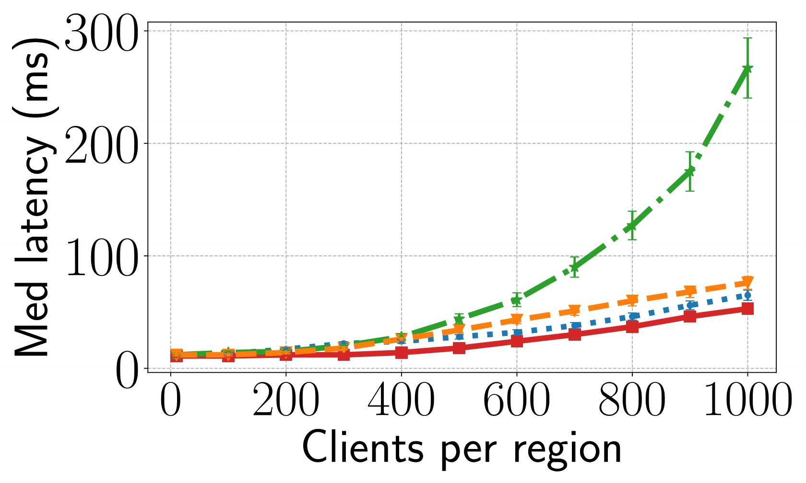
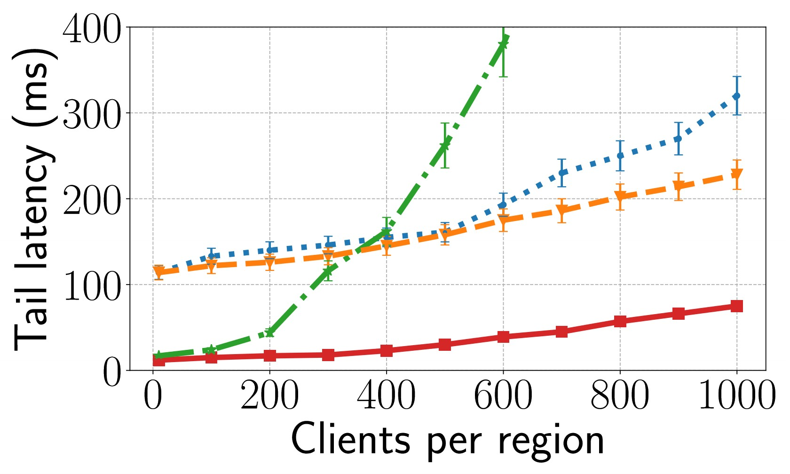
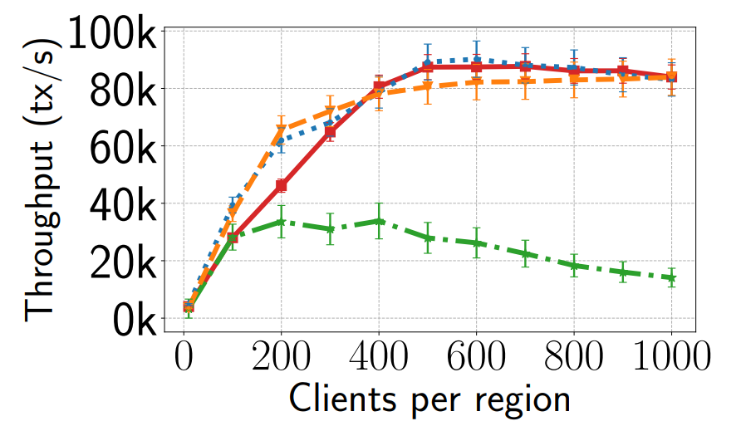
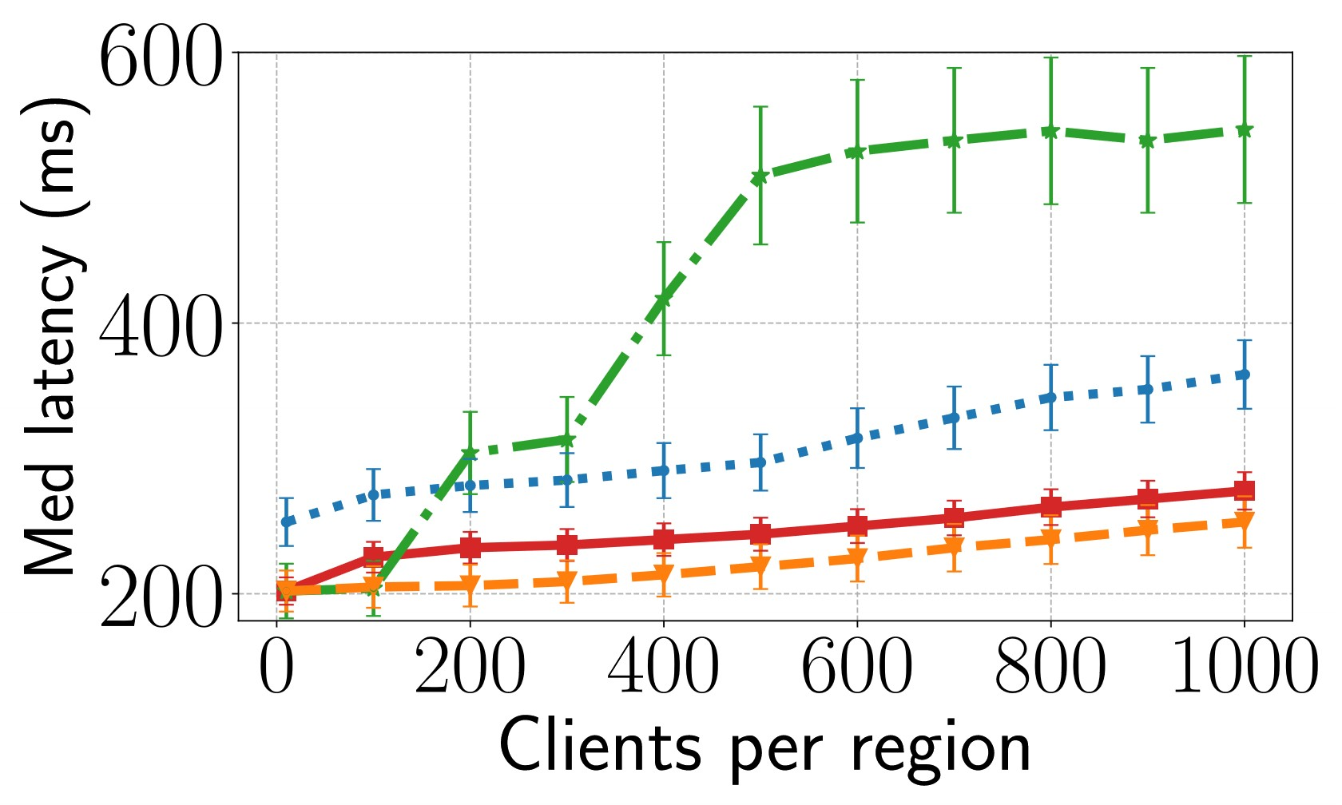
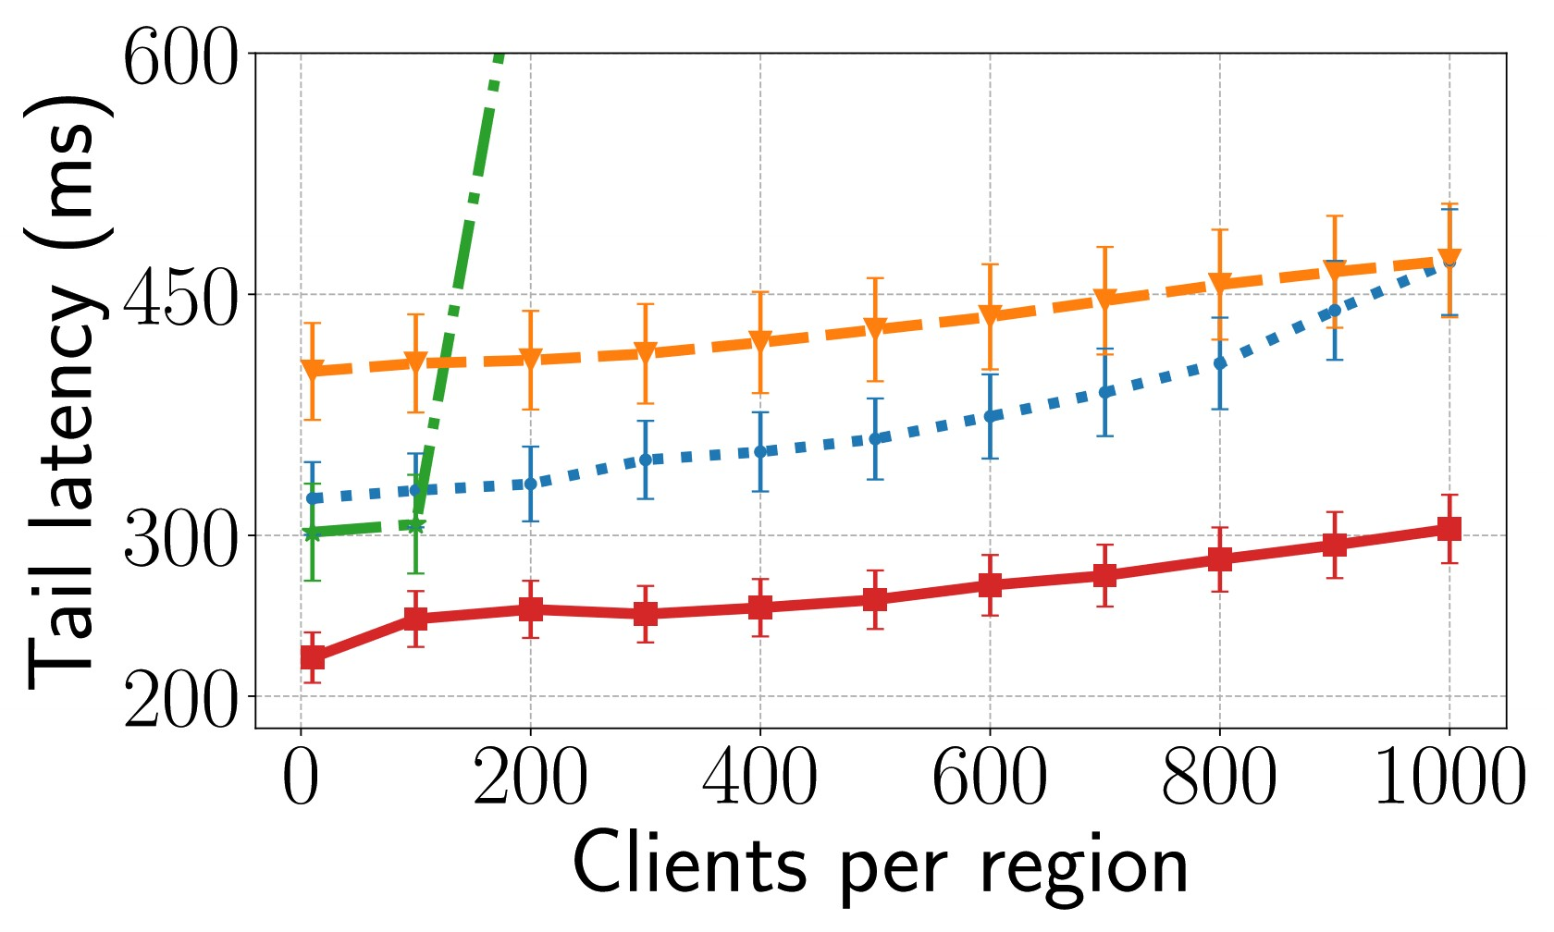
Performance on TPC-C default
Median latency
99% tail-latency
DAST
Janus [OSDI ’16]
TAPIR [SOSP ’15]
IRTs
SLOG [VLDB ’19]
CRTs
1. DAST reduces the IRT tail-latency by 87.9%~93.2%, and CRT tail latency for 27.7~70.4% compared to relevant systems.
2. DAST achieves comparable throughput to relevant systems.
Notes:
We first compare DAST and the three baseline systems under the default TPC-C workload.
We ran 10 regions and 10 shards per region and changed the number of clients per region.
The evaluation shows that, DAST’s greatly reduces the tail latency of both IRTs and CRTs, and at the same time, DAST’s throughput is comparable to the baseline systems.
Among these three baseline systems, Janus and SLOG take the SMR approach, and their IRT’s tail latency was higher than DAST because IRTs may be blocked by CRTs, but such blockings do not exist in DAST.
Tapir takes the deferred update optimistic approach, so its tail-latency is high on contended workload like TPC-C.

Slide 16
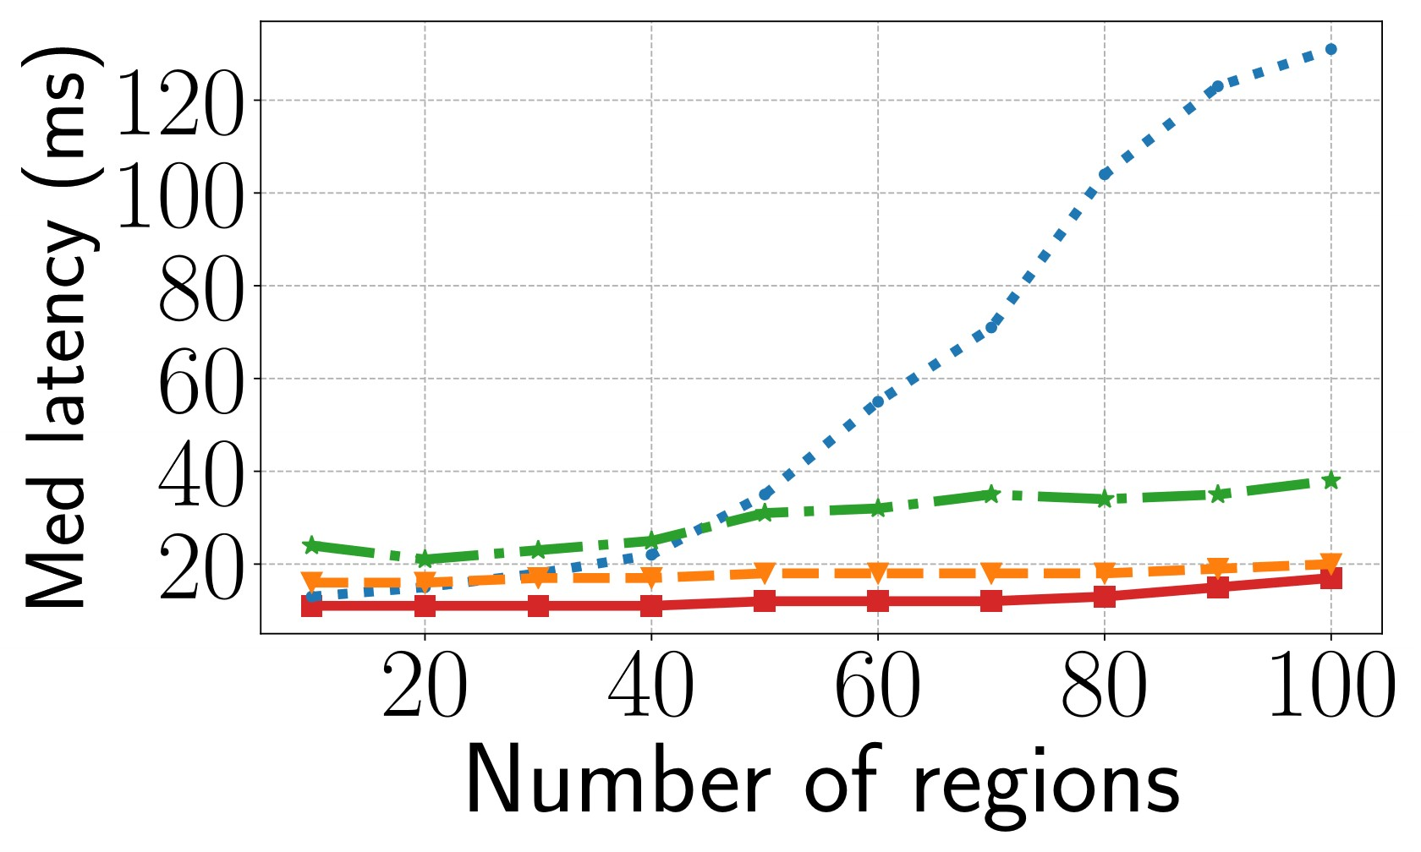
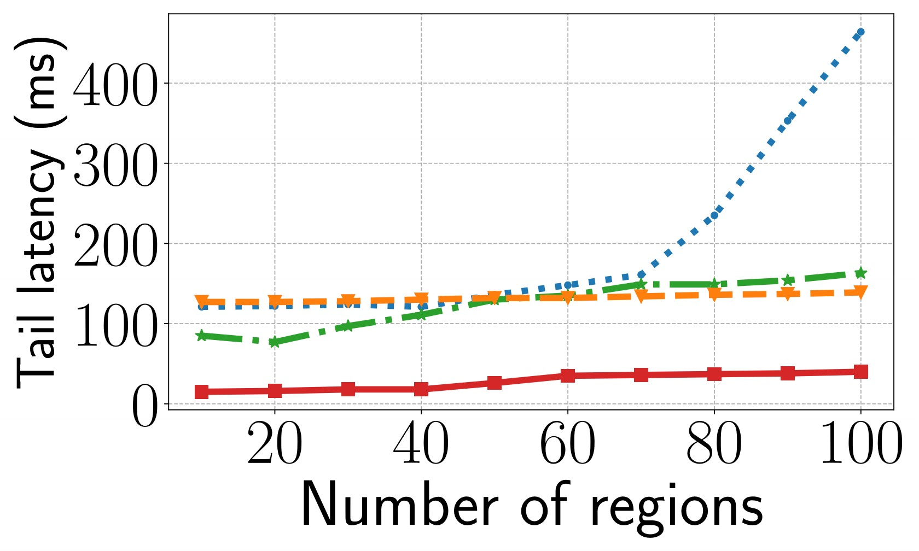
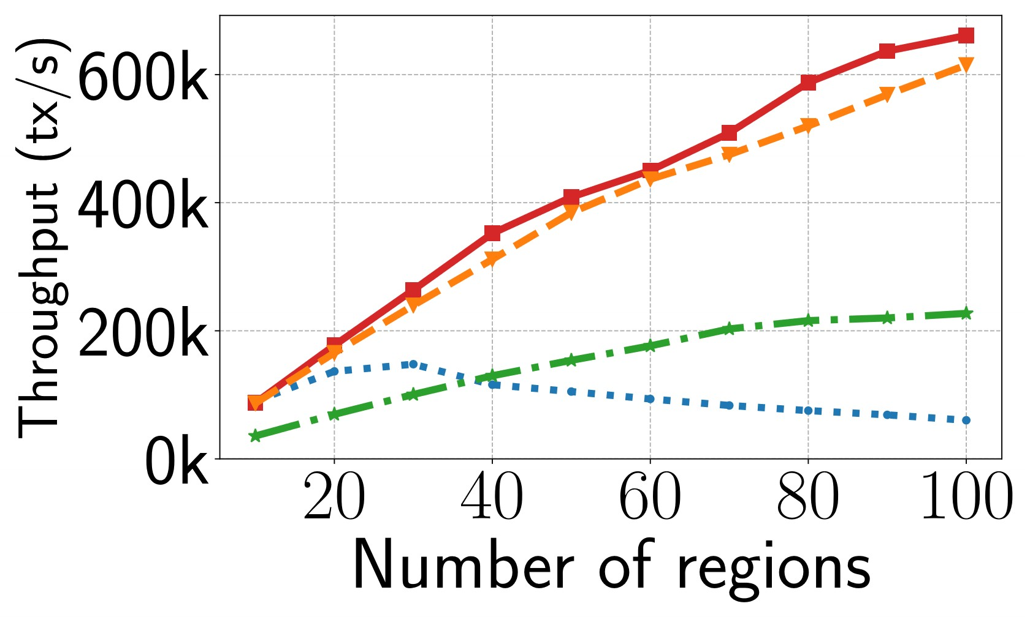
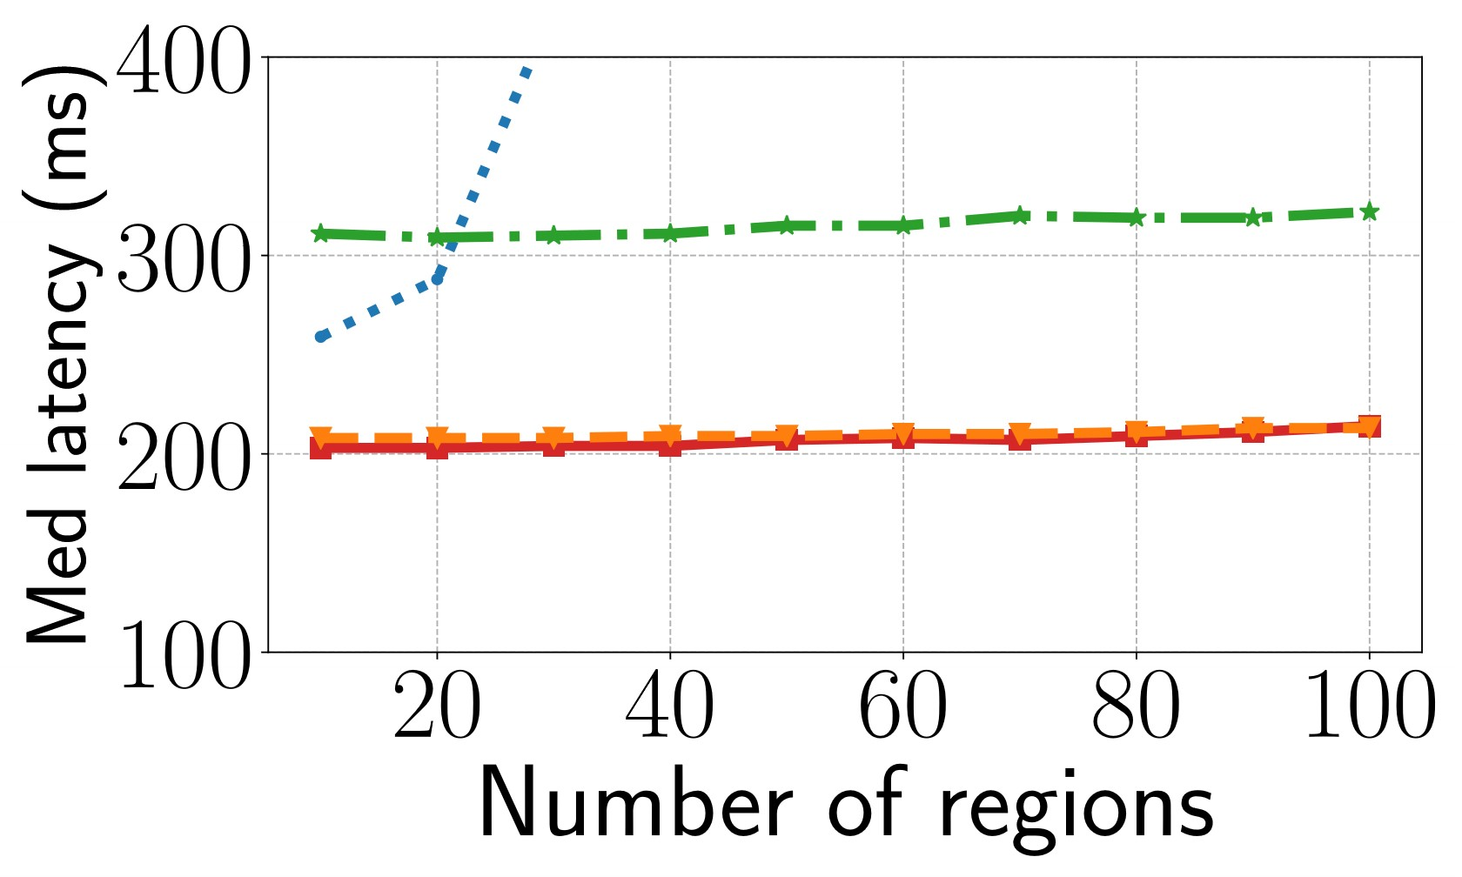
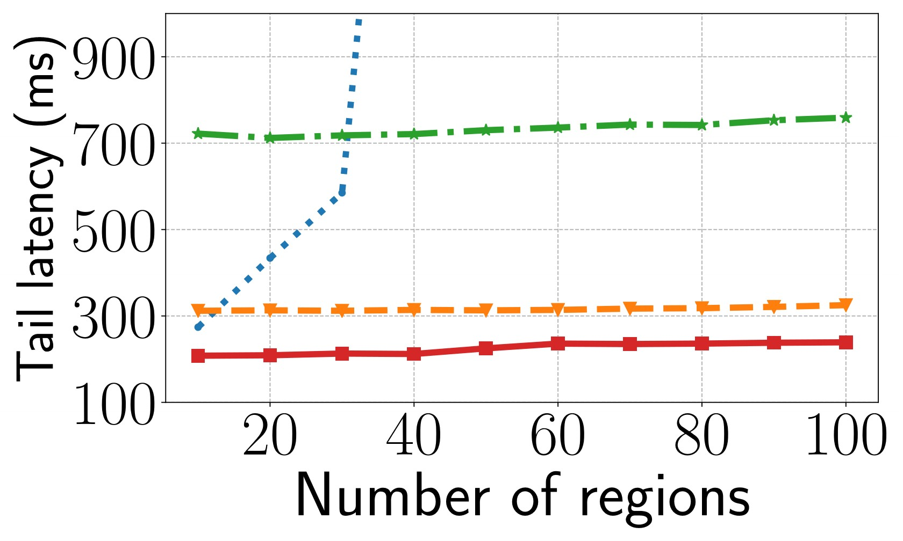
Scalability to the number of regions
Median latency
99% tail-latency
DAST
Janus [OSDI ’16]
TAPIR [SOSP ’15]
IRTs
SLOG [VLDB ’19]
CRTs
DAST’s performance is scalable to the number of regions.
Notes:
To evaluate the scalability of DAST of baseline systems, we selected the number of clients that make each system meet its peak throughput and change the number of regions.
Among these four systems, DAST, SLOG, and TAPIR achieve good scalability because in these systems, coordinating a CRT only involves relevant regions. While SLOG is designed for being deployed among a few core data centers, so when the total number of regions is large, the central ordering service can easily become the bottleneck.

Slide 17
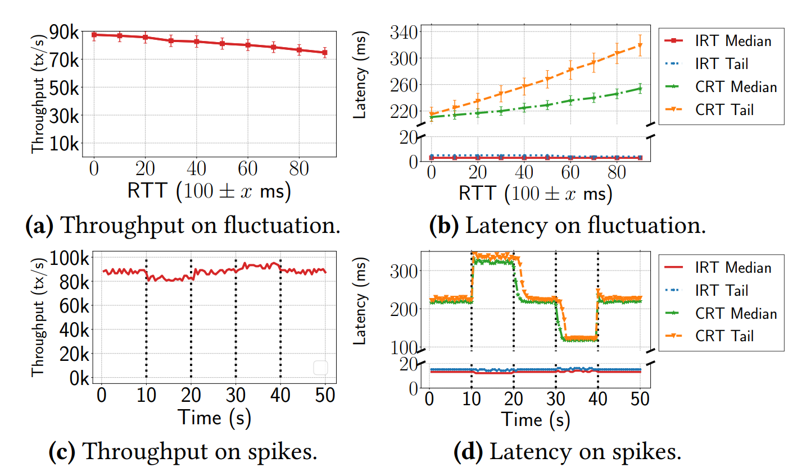
Robustness under cross-region network anomalies
We change the cross-region RTT from 100ms to (100 ± x) ms.
We increase/decrease the cross-region at each vertical dotted line.
Notes:
To test DAST’s robustness, we did two experiments.
In the first experiment, we let the cross-region RTT two fluctuate as 100+- x milliseconds.
As shown by the top two figures, IRTs median and tail latency was stable because IRTs were coordinated within each region, and inaccurate anticipation is already handled by DAST’s hybrid clock.
CRTs median and tail latency increased roughly linearly, which is as expected because the network communication time for CRTs did increase.
The overall throughput only dropped a little because most throughput was contributed by IRTs.
In the second experiment, instead of letting the RTT fluctuate among a stable value, we suddenly change the RTT at each vertical dotted line to mimic the effect of network spikes. As shown in the figure, IRTs latency was still stable. When the RTT dropped, the drop of CRT’s latency fell behind a little because DAST uses the average RTT of recent communication to anticipate timestamps of CRTs.
Overall, DAST’s performance was stable on cross-region network anomalies.

Slide 18
Conclusion
DAST is the first edge computing database that ensures serializability, low tail-latency, and high scalability.
Existing edge computing databases do not ensure serializability.
Traditional geo-distributed databases are not designed for meeting R1, R2, R3 on edge.
DAST has the potential to deploy many mission-critical edge computing applications.
Real-time traffic management& vehicular networks [EdgeSys ’21, EdgeSys ’19, EdgeSys ‘18].
Health monitoring& ambulance arrangement [EdgeSys ’20].
Integration of UAV system into national airspace system [NASA].
Trading & retailing [Transactions on SMC ’19, ICC ’19, ICEC ’18, Goldman Sachs].
Industrial management systems [IEEE Comm ’18, ToII ’19]
DAST’s artifact is available on https://github.com/hku-systems/dast.
Notes:
Now we conclude.
DAST is first edge computing database that ensure …..
It has potential to support the deployment of many emerging mission-crucial edge computing application like. ..
Our artifact is evaluated and accessible from github.
Thank you all for listening.

